Slide 1
Research Methodology
Akshata S. Bhayyar
Assistant Professor
Dept.of CSE, RIT

Slide 2
Contents
Meaning of Research,
Objectives of Research,
Types of Research,
Ethics in Research,
Types of Research Misconduct.
Literature Review and Technical Reading

Slide 3



MEANING OF RESEARCH

Slide 4
MEANING OF RESEARCH
Research in common parlance refers to a search for knowledge.
Once can also define research as a scientific and systematic search for pertinent information on a specific topic.
A careful investigation or inquiry especially through a search for new facts in any branch of knowledge.
1 Redman and Mory define research as a “systematized effort to gain new knowledge.
2 Some people consider research as a movement, a movement from the known to the unknown. It is actually a voyage of discovery.

Slide 5
MEANING OF RESEARCH
Research is an academic activity
Clifford Woody research comprises
Defining and redefining problems,
Formulating hypothesis or suggested solutions;
Collecting, organizing and evaluating data;
Making deductions and reaching conclusions;
and at last carefully testing the conclusions to determine whether they fit the formulating hypothesis.

Slide 6
MEANING OF RESEARCH
D. Slesinger and M. Stephenson in the Encyclopaedia of Social Sciences define research as
The manipulation of things, concepts, or symbols for the purpose of generalizing to extend,
Correct or verify knowledge,
Whether that knowledge aids in the construction of theory or in the practice of an art.”
Research is, thus, an original contribution to the existing stock of knowledge making for its advancement.
It is the pursuit of truth with the help of study, observation, comparison and experiment.

Slide 7
OBJECTIVES OF RESEARCH
The purpose of research is to discover answers to questions through the application of scientific procedures.
The main aim of research is to find out the truth which is hidden and which has not been discovered as yet.
Though each research study has its own specific purpose, we may think of research objectives as falling into a number of following broad groupings:
1. To gain familiarity with a phenomenon or to achieve new insights into it (studies with this object in view are termed as exploratory or formative research studies);
2. To portray accurately the characteristics of a particular individual, situation or a group (studies with this object in view are known as descriptive research studies);
3. To determine the frequency with which something occurs or with which it is associated with something else (studies with this object in view are known as diagnostic research studies);
4. To test a hypothesis of a causal relationship between variables (such studies are known as hypothesis-testing research studies)

Slide 8
MOTIVATION IN RESEARCH
The possible motives for doing research may be either one or more of the following:
1. Desire to get a research degree along with its consequential benefits;
2. Desire to face the challenge in solving the unsolved problems, i.e., concern over practical problems initiates research;
3. Desire to get intellectual joy of doing some creative work
4. Desire to be of service to society
5. Desire to get respectability

Slide 9
TYPES OF RESEARCH
The basic types of research are as follows:
Descriptive vs. Analytical
Applied vs. Fundamental
Quantitative vs. Qualitative
Conceptual vs. Empirical
Some Other Types of Research

Slide 10

TYPES OF RESEARCH : Descriptive vs. Analytical

Slide 11
TYPES OF RESEARCH : Descriptive vs. Analytical
Descriptive research includes surveys and fact-finding inquiries of different kinds.
The major purpose of descriptive research is description of the state of affairs as it exists at present.
The main characteristic of this method is that the researcher has no control over the variables; he can only report what has happened or what is happening.
Most ex post facto research projects are used for descriptive studies in which the researcher seeks to measure such items as, for example, frequency of shopping, preferences of people, or similar data.
Ex post facto studies also include attempts by researchers to discover causes even when they cannot control the variables.
The methods of research utilized in descriptive research are survey methods of all kinds, including comparative and correlational methods.
In analytical research, on the other hand, the researcher has to use facts or information already available and analyze these to make a critical evaluation of the material.

Slide 12


TYPES OF RESEARCH : Applied vs. Fundamental

Slide 13
TYPES OF RESEARCH : Applied vs. Fundamental
Applied research aims at finding a solution for an immediate problem facing a society or an industrial/business organization, whereas fundamental research is mainly concerned with generalizations and the formulation of a theory.
Example: Research concerning some natural phenomenon or relating to pure mathematics are examples of fundamental research.
Example: research studies, concerning human behaviour carried on with a view to making generalizations about human behavior, are also examples of fundamental research, but research aimed at certain conclusions (say, a solution) facing a concrete social or business problem is an example of applied research.
Example: Research to identify social, economic or political trends that may affect a particular institution or copy research marketing research or evaluation research are examples of applied research.
Thus, the central aim of applied research is to discover a solution for some pressing practical problem, whereas basic research is directed towards finding information that has a broad base of applications and thus, adds to the already existing organized body of scientific knowledge

Slide 14

TYPES OF RESEARCH : Quantitative vs. Qualitative

Slide 15
TYPES OF RESEARCH : Quantitative vs. Qualitative
Quantitative research is based on the measurement of quantity or amount.
Qualitative research, on the other hand, is concerned with qualitative phenomenon, i.e., phenomena relating to or involving quality or kind.
For instance, when we are interested in investigating the reasons for human behavior (qualitative research)
This type of research aims at discovering the underlying motives and desires, using in-depth interviews for the purpose.
Other techniques of such research are word association tests, sentence completion tests, story completion tests, and similar other projective techniques.
Attitude or opinion research i.e., research designed to find out how people feel or what they think about a particular subject or institution is also qualitative research.
Through such research we can analyse the various factors which motivate people to behave in a particular manner or which make people like or dislike a particular thing.
one should seek guidance from experimental psychologists.

Slide 16
TYPES OF RESEARCH : Conceptual vs. Empirical
Conceptual research is that related to some abstract idea(s) or theory.
It is generally used by philosophers and thinkers to develop new concepts or to reinterpret existing ones.
Empirical research relies on experience or observation alone, often without due regard for system and theory.
It is data-based research, coming up with conclusions that are capable of being verified by observation or experiment. We can also call it as experimental type of research.
In such research, the researcher must first provide himself with a working hypothesis or guess as to the probable results.
He then works to get enough facts (data) to prove or disprove his hypothesis.
He then sets up experimental designs
Such research is thus characterized by the experimenter’s control over the variables

Slide 17
TYPES OF RESEARCH : Some Other Types of Research
All other types of research are variations of one or more of the above stated approaches, based on either the
purpose of research,
the time required to accomplish research,
the environment in which research is done,
or on the basis of some other similar factor.
From the point of view of time, we can think of research either as one-time research or longitudinal research.
Research can be field-setting research or laboratory research or simulation research, depending upon the environment in which it is to be carried out.
Research can also be understood as clinical or diagnostic research.
Such research follows case-study methods. Such studies usually go deep into the causes of things or events that interest us, using very small samples and very deep probing data gathering devices.

Slide 18
TYPES OF RESEARCH : Some Other Types of Research
The research may be exploratory or it may be formalized.
The objective of exploratory research is the development of hypotheses rather than their testing, whereas formalized research studies are those with substantial structure and with specific hypotheses to be tested.
Historical research is that which utilizes historical sources like documents, remains, etc. to study events or ideas of the past, including the philosophy of persons and groups at any remote point in time.
Research can also be classified as conclusion-oriented and decision-oriented.
While doing conclusion-oriented research, a researcher is free to pick up a problem, redesign the enquiry as he proceeds and is prepared to conceptualize as he wishes.
Decision-oriented research is always for the need of a decision maker and the researcher in this case is not free to embark upon research according to his own inclination.
Operations research is an example of decision oriented research since it is a scientific method of providing executive departments with a quantitative basis for decisions regarding operations under their control.

Slide 19
The important features of a research design
A plan
Specify the sources & types of information relevant to the research problem
A strategy
Which approach will be used for gathering and analyzing the data
The time and budgets
Most studies are done under these two constraints

Slide 20
CHARACTERISTICS OF RESEARCH
Systematic- All steps must be inter related- one to another
Logical- Agreeing with the principles of logic
Empirical-Conclusions should be based on evidences/observations

Slide 21
CHARACTERISTICS OF RESEARCH…
Objectivity- It must answer the research questions
Replicable- reproducible
Transmittable
Quality control- Accurate measurements
All well designed and conducted research has potential application

Slide 22
Define Your objectives
Try to keep these simple
The more variables the more difficult
Use the opportunity
Get help at this stage
Senior colleagues
Experienced researchers

Slide 23
Literature search
Check to see if your idea is original
Get articles
Read articles and their references
Most of these will be vital when writing up reports
Find gap areas
Find obsolete measurements and results
Define objectives of the study

Slide 24
Steps involved in a research
Choose a subject
Literature survey
Defining and formulation of specific objectives
Prepare Synopsis
Procuring of suitable apparatus/materials
Design of experimental set up
Preliminary experiments
Execution of the project
Accurate measurements/data collection

Slide 25
Steps involved in a research…
Data analysis and error compounding
Hypothesis testing and verification
Results and discussion
Generalization, interpretation and drawing conclusions
Preparation of the project report or writing thesis

Slide 26
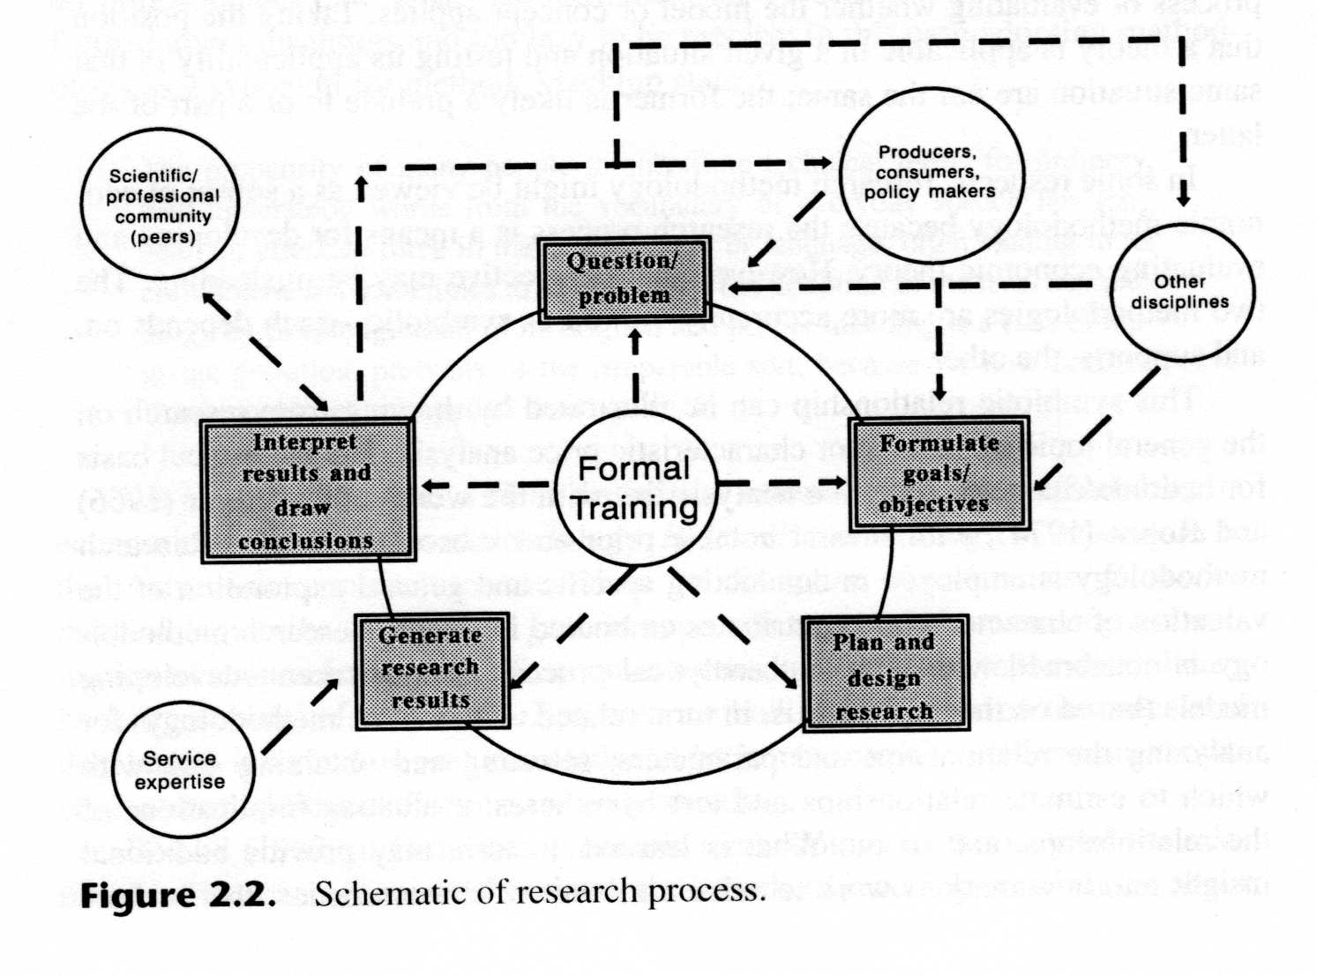
The Process of Research
1
5
2
4
3

Slide 27
Research article writing
Find suitable/specified journals
Get copy of Instructions to authors
Prepare article as per instructions
Select suitable titles
Authors and affiliations
Abstract
Highlights
Novelty statements
Introduction
Materials and methods
Results and discussion
Conclusions
Acknowledgements
References

Slide 28
Authorship/ethics
All authors should directly involved in entire study
Article is free from plagiarism
Should follow ethics

Slide 29
A Research Report
A Research Report generally include:
Introduction and Statement of problem
Review of relevant literature
Statement of hypothesis or research objectives
Theoretical resume
Description of research design
Description Experimental design
Description of measurement and data analysis
Error compounding
Presentation of Results
Discussion
Conclusion, limitations, and implications
Suggestions for future work
Acknowledgements
References cited
Appendices

Slide 30
Types of research
1. Application- Pure and Applied Research
Applied- Finding solutions for immediate problems facing a society/industry
Pure- Concerned with generalization and formulation of a theory
2. Inquiry Mode- Quantitative and qualitative
Quantitatative- Measurements of quantity or amount
Qualitative- Concerned with qualitative phenomena (reasons for human behavior)

Slide 31
Research Studies
Based on research objectives:
Exploratory or formulative research- To gain familiarity with a phenomenon or to achieve new insights into it
descriptive research- To study accurately the characteristics of a particular individual, situation or a group-includes survey

Slide 32
Research Studies
Diagnostic research- To determine the frequency with which something occurs or with which it is associated with something else
hypothesis-testing research- To test a hypothesis of a causal relationship between variables

Slide 33
Thank you
“Science is not belief, but the will to find out.”

